Slide 1
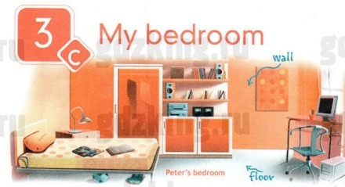
The 7th of December
My bedroom

Slide 2
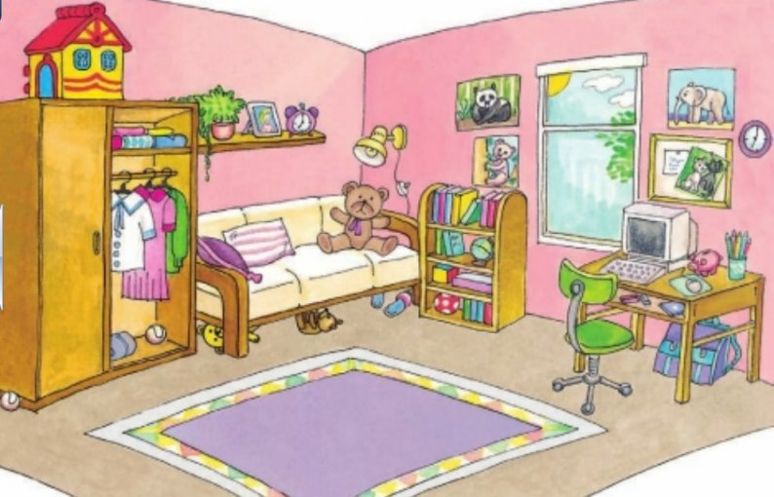
Read the words:
Wardrobe
Bed
Lamp
Desk
Bookcase
Books
Carpet

Slide 3
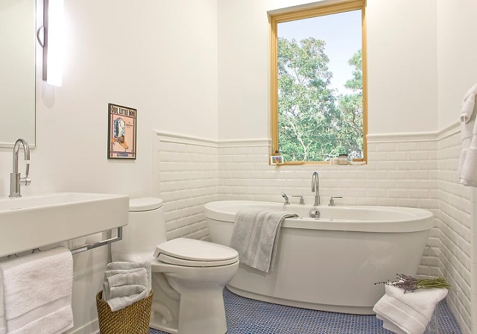
Bathroom
Mirror
Washbasin
Bath
Toilet

Slide 4
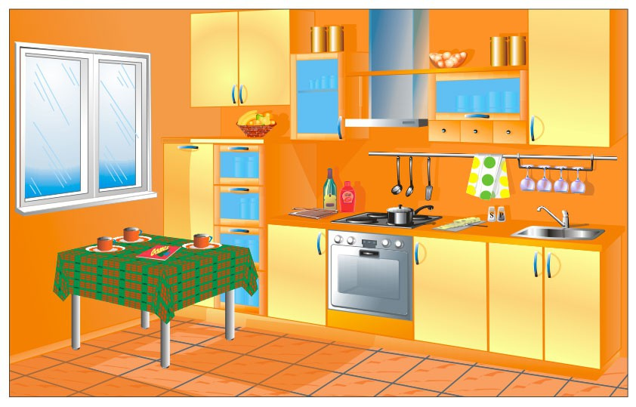
Kitchen
Sink
Cooker
Fridge
Chairs
Table

Slide 5
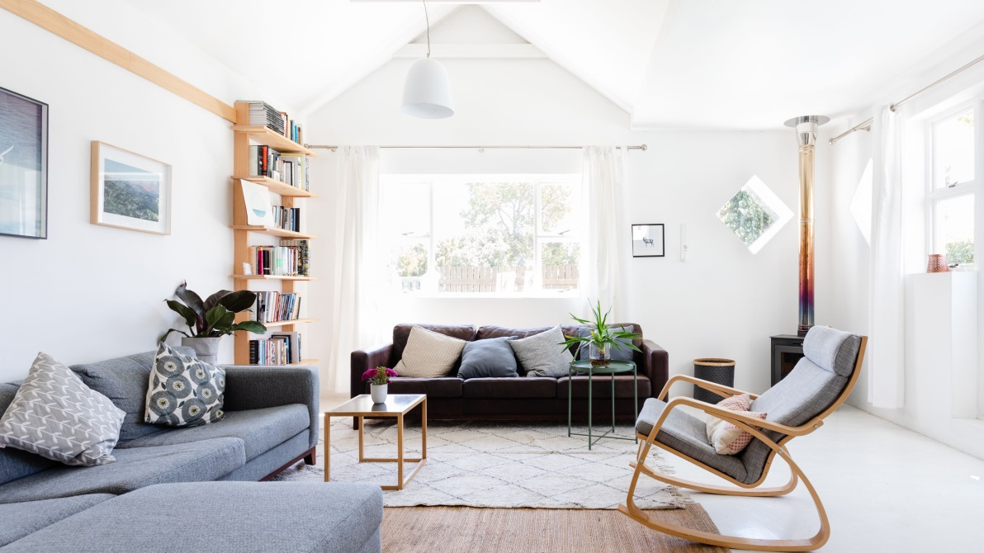
Living room
Paintings
Armchair
Window
Sofa
Coffee table

Slide 6
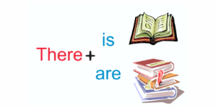
Complete the sentences:
There ____ two chairs in the kitchen.
There ____ a bed in my bedroom.
There ____ a sofa in the living room.
There ____ any a TV in the kitchen

Slide 7
Possessive adjectives
Singular | Plural
my | our
your | your
his/her/its | their

Slide 8
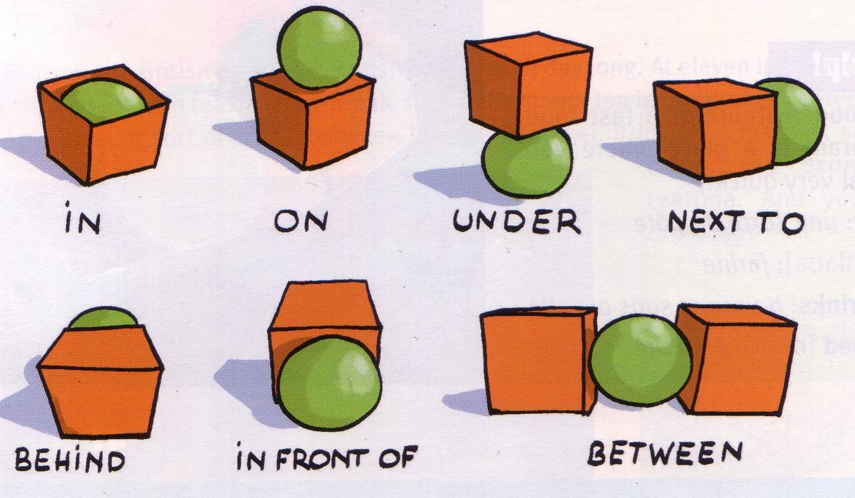
Prepositions of place

Slide 9
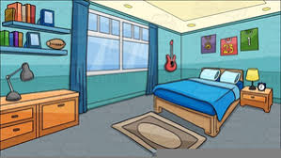
Reading (ex. 2 page 50)
Read the title. Think of 6 words you expect to find in the text. Read and check

Slide 10
Asking about location
A: Is there a desk in your bedroom?
B: Yes, there is.
A: Where exactly is it?
B: It’s under the window next to my bed.

Slide 11
HOMEWORK
Упражнение 5 стр. 50
Напишите рассказ о своей комнате (30-50 слов), используйте упр. 2 как модель.

