Slide 1
The 8th of February. (Monday)
Wake up!

Slide 2
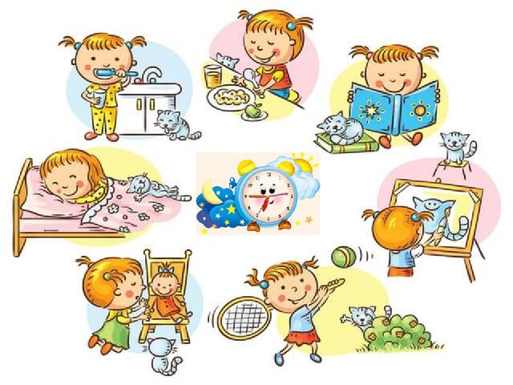
Read a poem
One, two
I go to school
Three, four
I play outdoor
Five, six
I read my books
Seven, eight
I am never late
Nine, ten
I sleep by then.

Slide 3
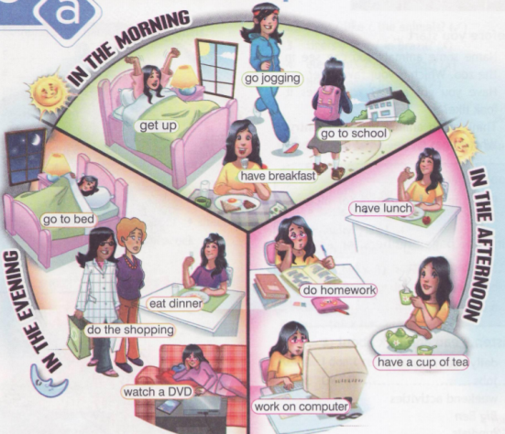
Look at the pictures. What does Sally do in the morning/ in the afternoon/ in the evening?

Slide 4
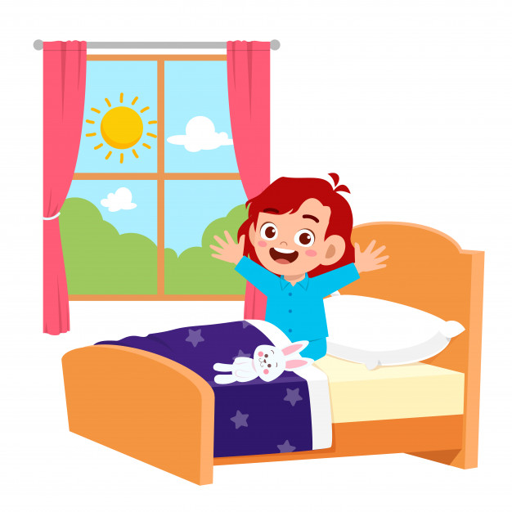
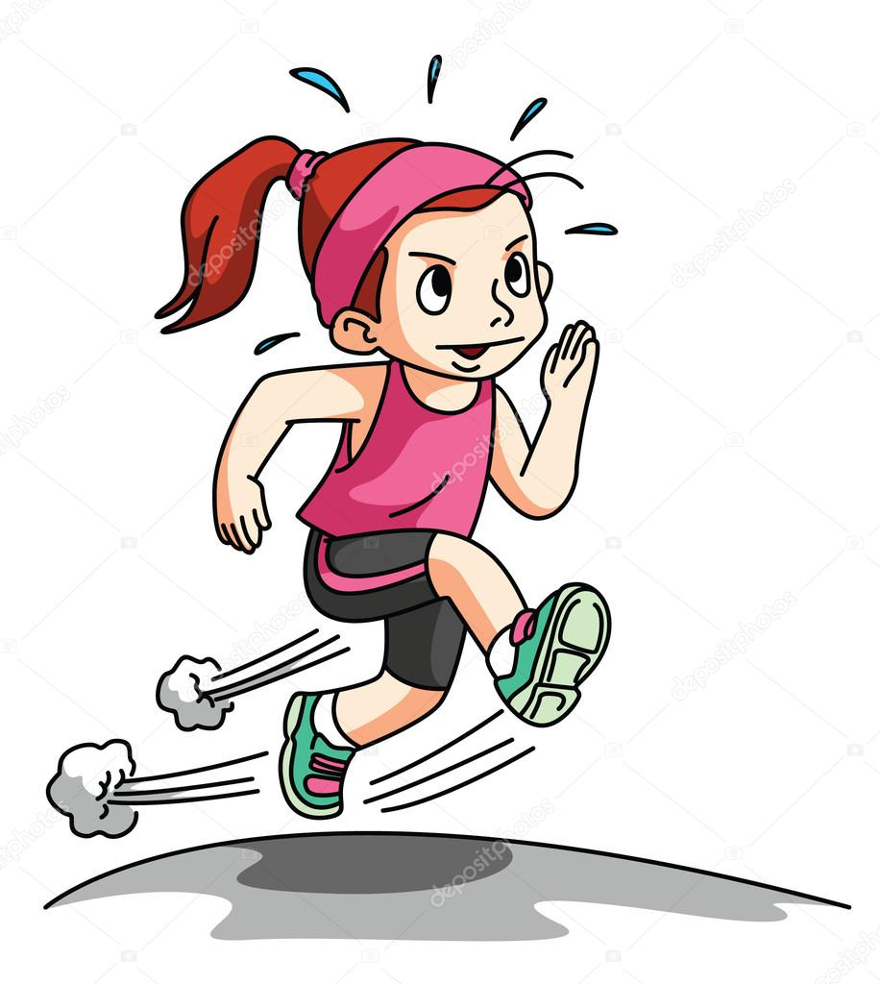
go jogging
Wake up

Slide 5
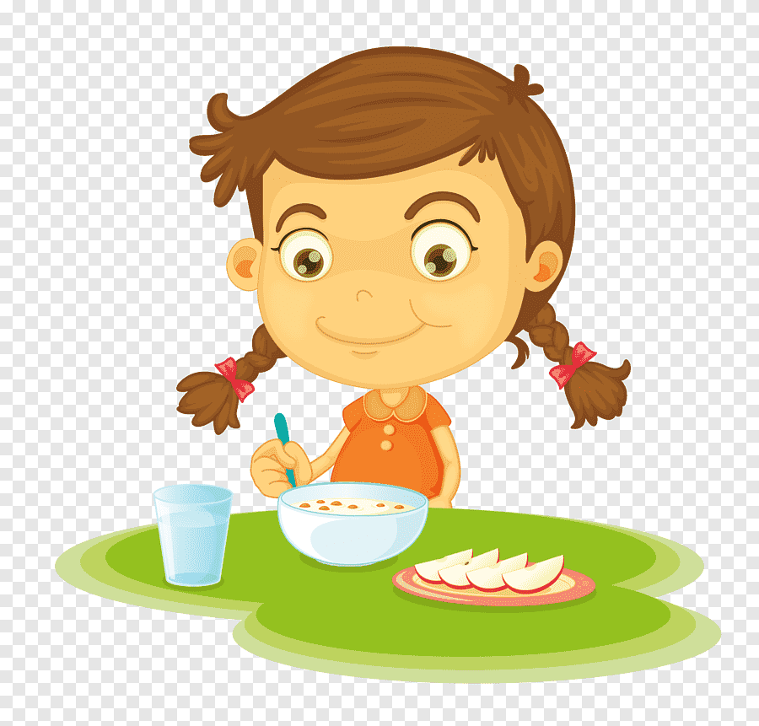
Go to school
Have breakfast

Slide 6
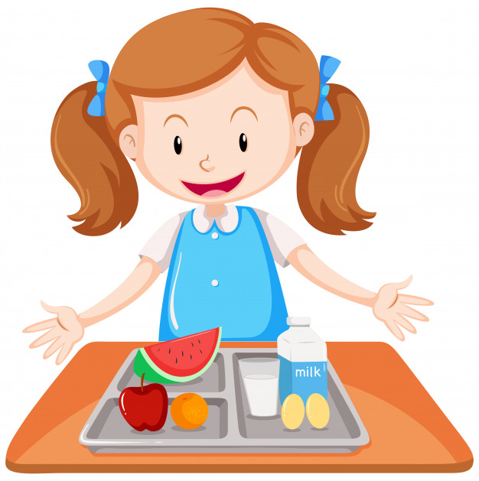
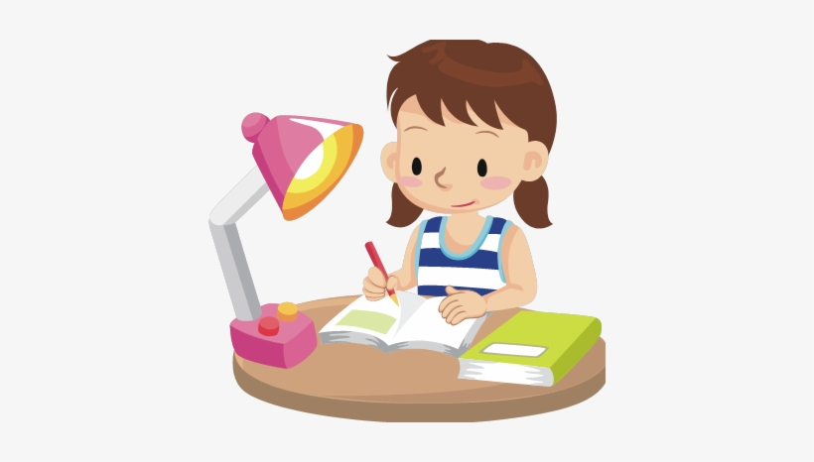
Do homework
Have lunch

Slide 7
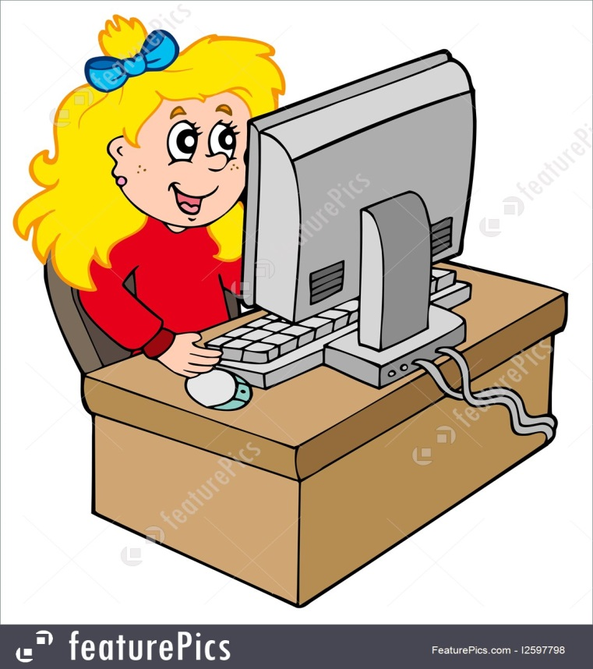
Work on computer
Have a cup of tea

Slide 8
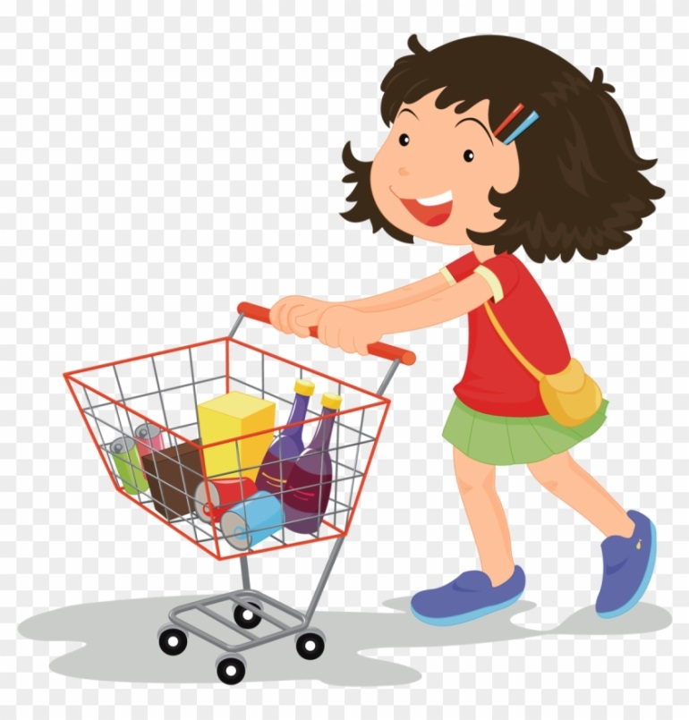
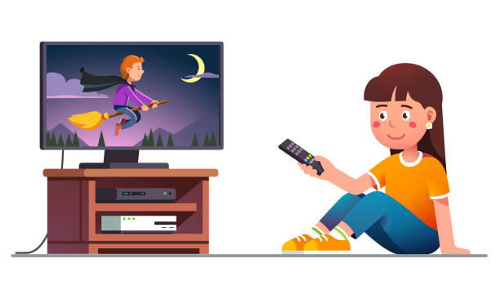
watch a DVD
Go shopping

Slide 9
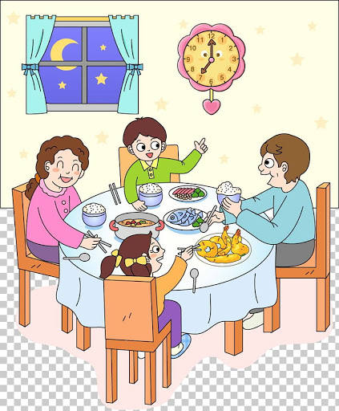
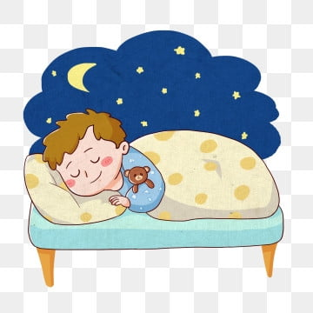
go to bed
eat dinner

Slide 11
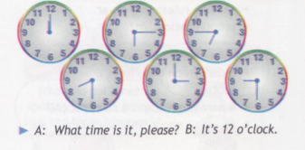
Asking about the time | Telling about the time
What time is it, please? Have you got the time, please? Excuse me, what’s the time, please? | It’s five o’clock. It’s half past five. It’s quarter past six.

Slide 12
Adverbs of Frequency
Always – всегда
Usually – обычно
Often – часто
Sometimes – иногда
Never – никогда

Slide 13
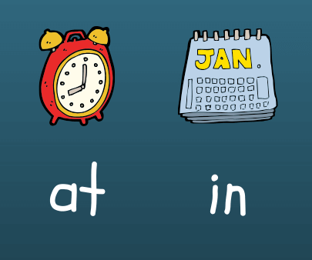
at + (the time),
at 3 o’clock
at noon
at midnight
at night
in + in the morning
in the afternoon
in the evening

Slide 14
Homework
Ex. 7 page 77

